Slide 1
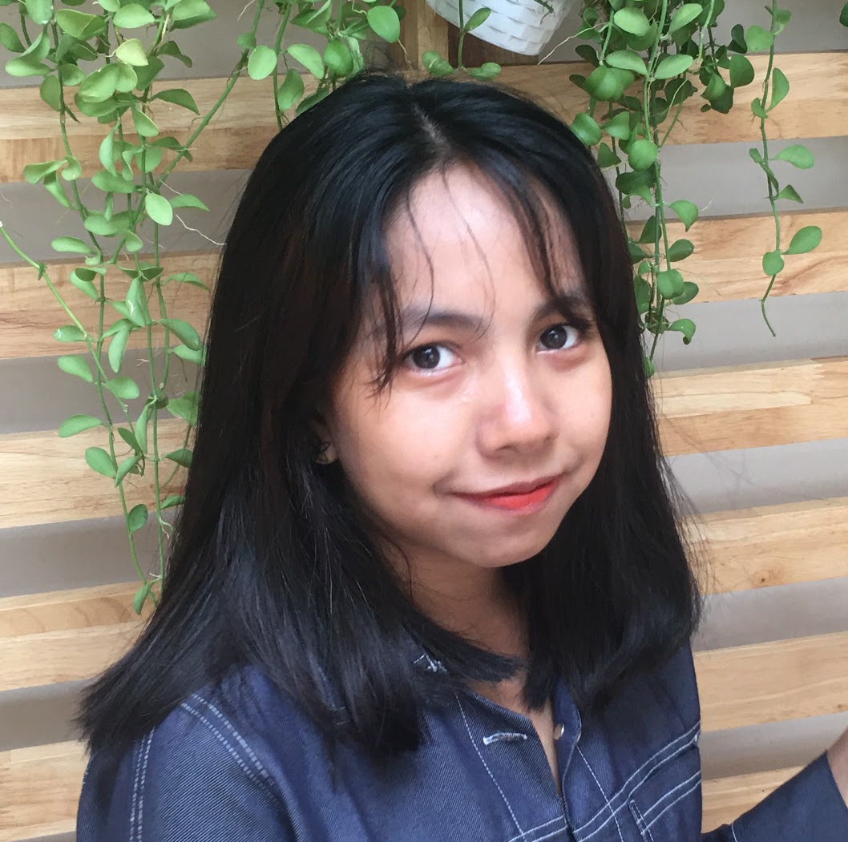
WEB DEVELOPMENT
(PHP) Final Project
Presented by
Shinn Thant Khin

Slide 2


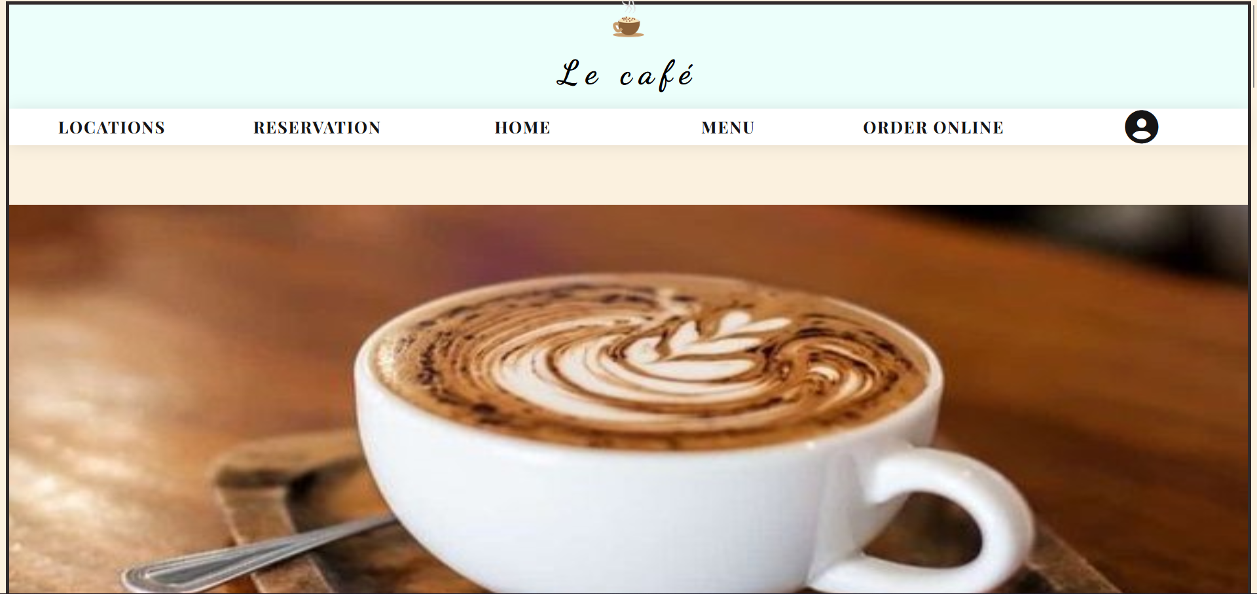
Le café
Coffee Shop

Slide 3
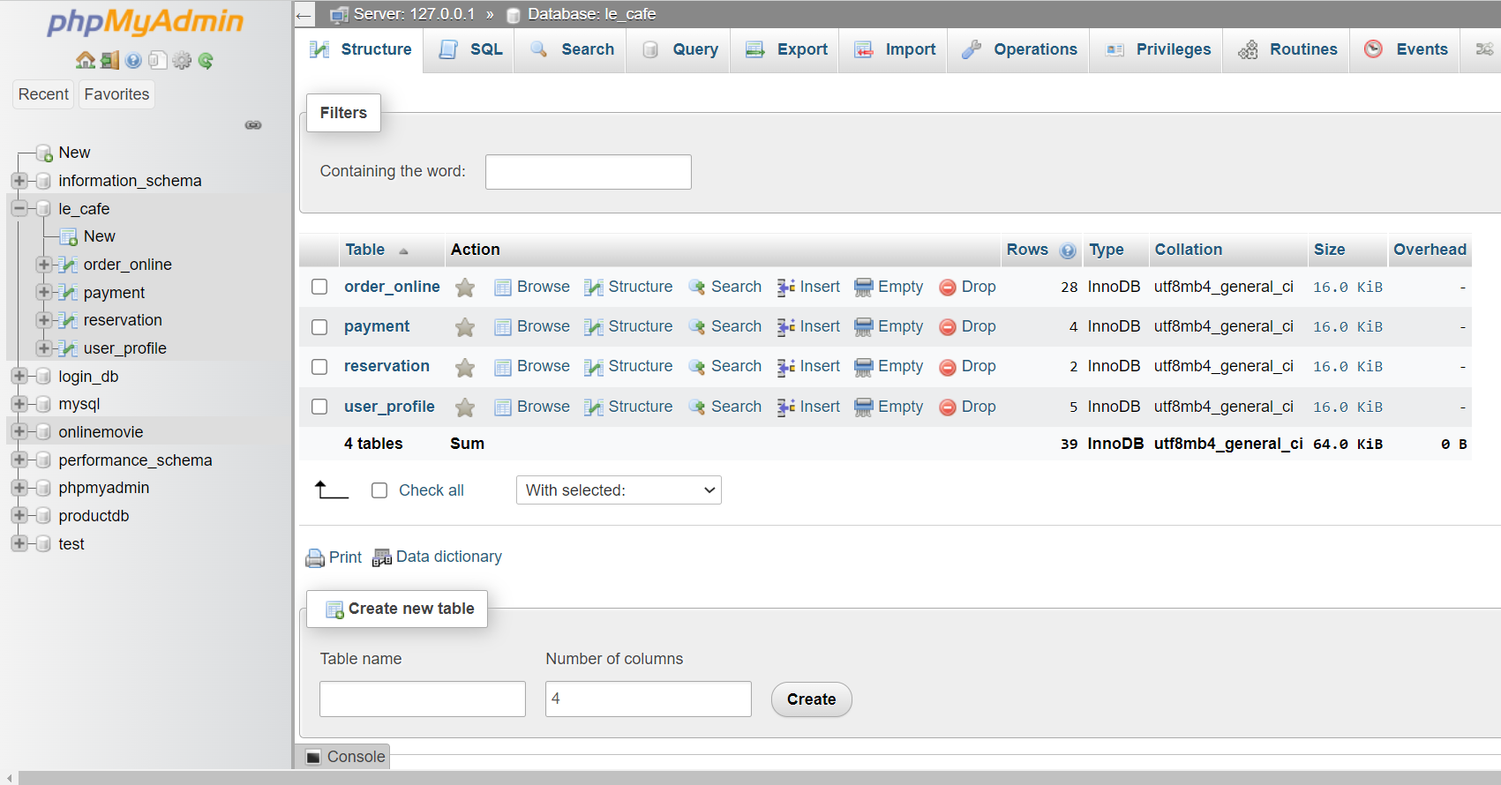
Database
Materials
le_cafe database
4 tables

Slide 4
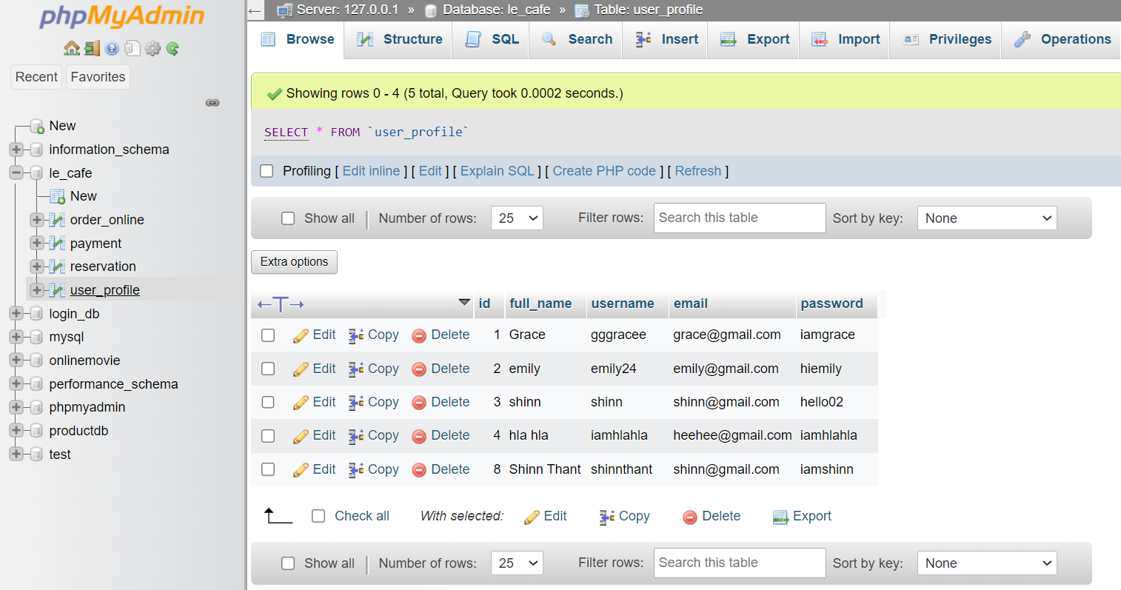
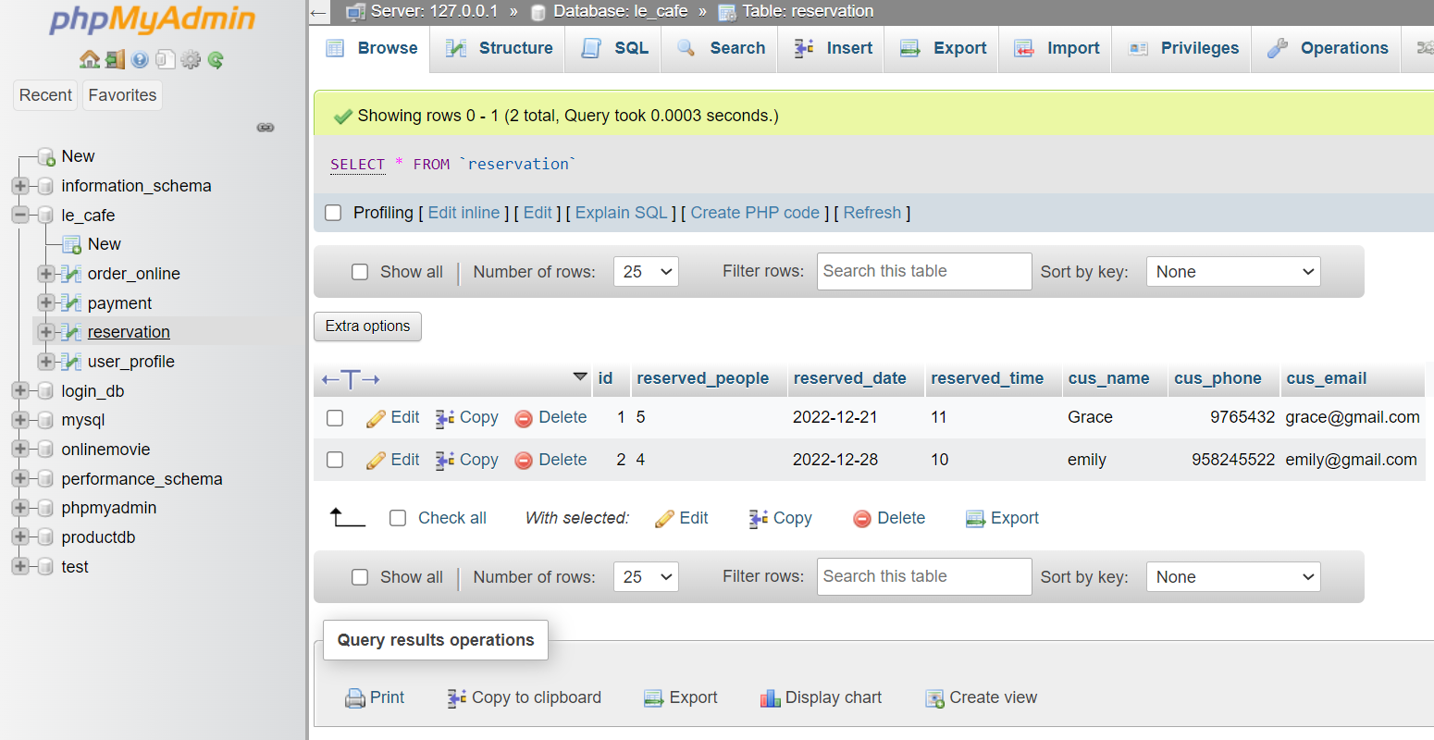
Database
Materials
Reservation Table
User_profile table

Slide 5
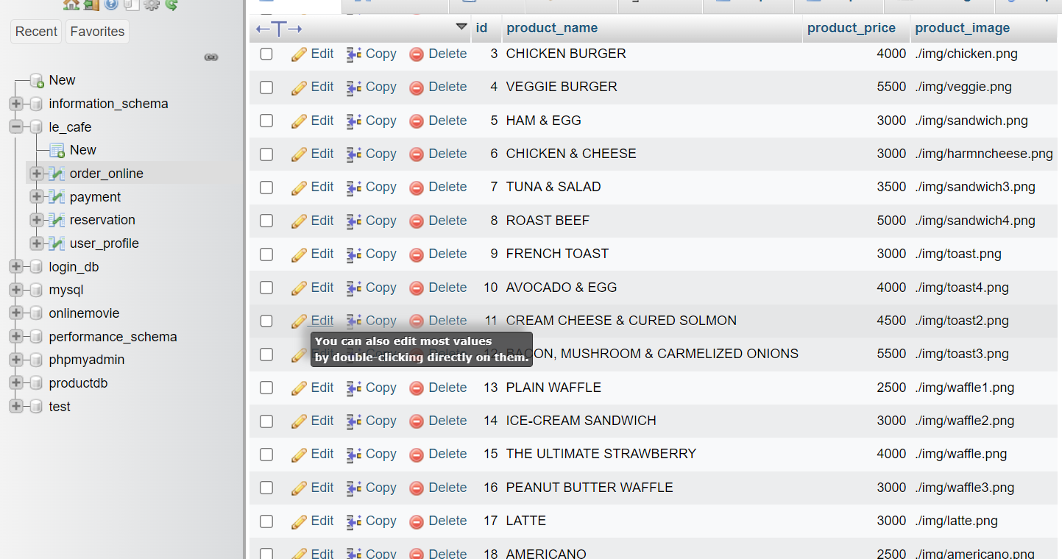
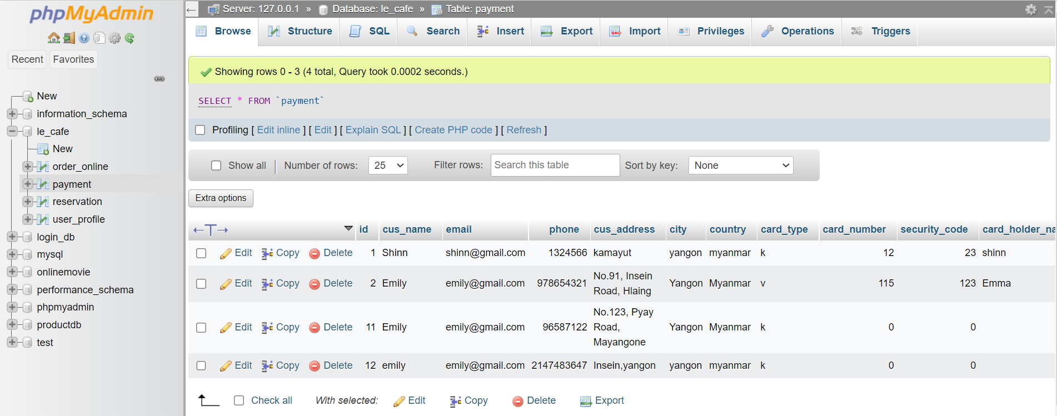
Database
Materials
Payment Table
Online_Order Table

Slide 6
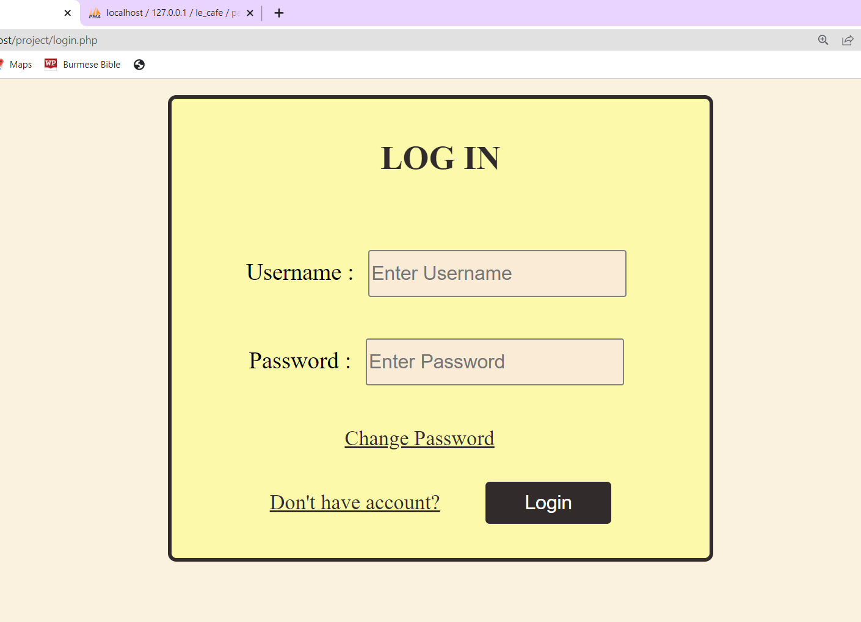
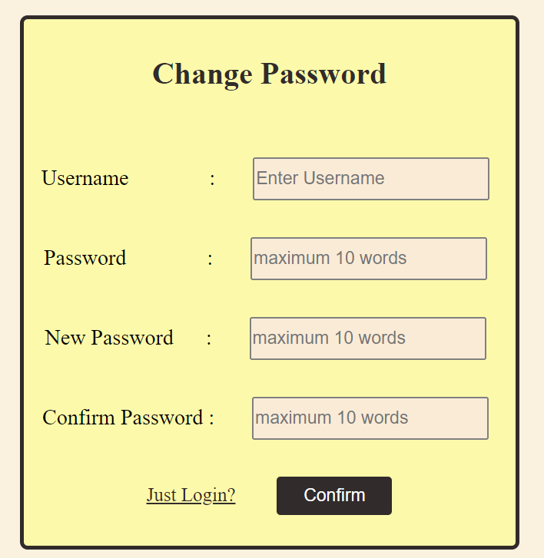
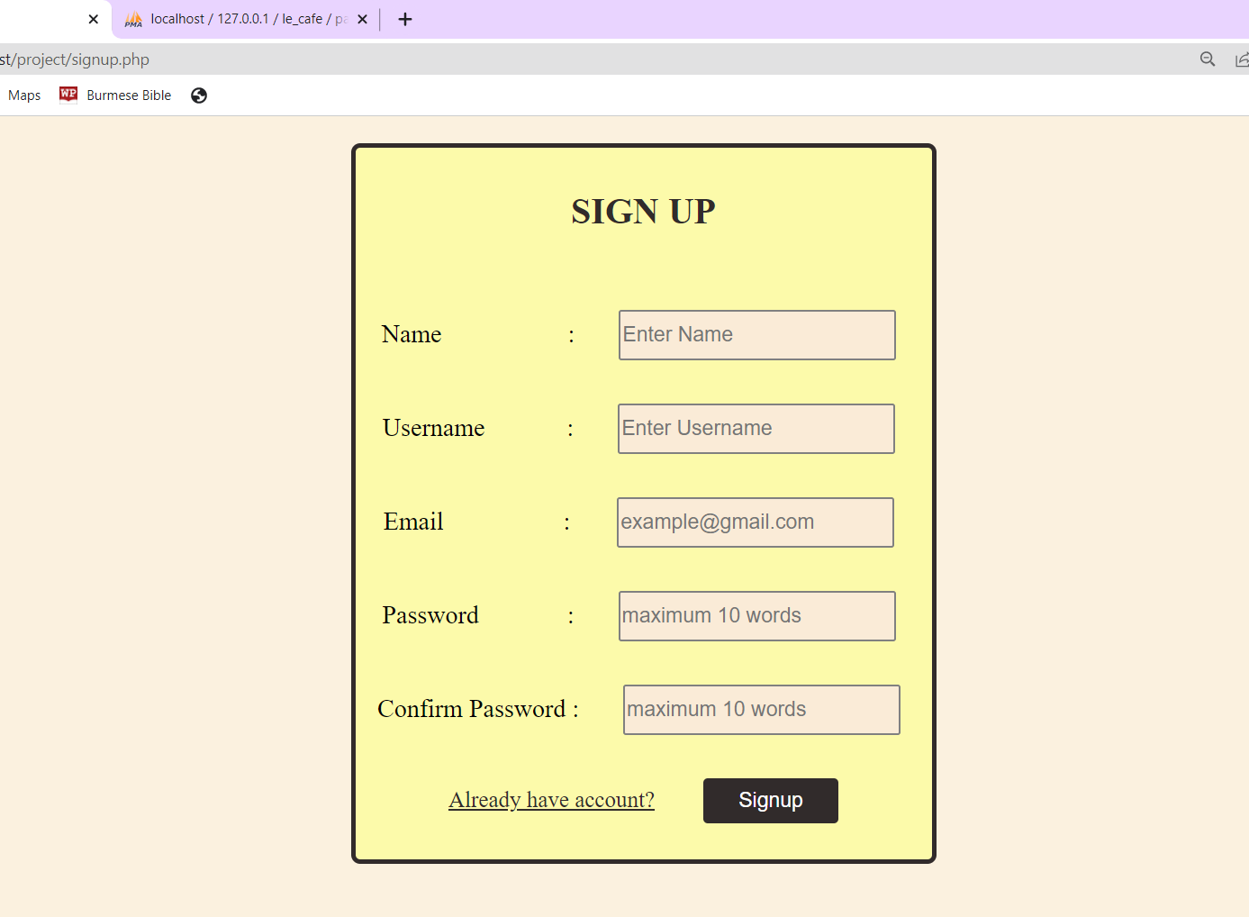
Website
Materials
Need to log in to use the website
Can change password
Can sign up for account if you don’t have one

Slide 7
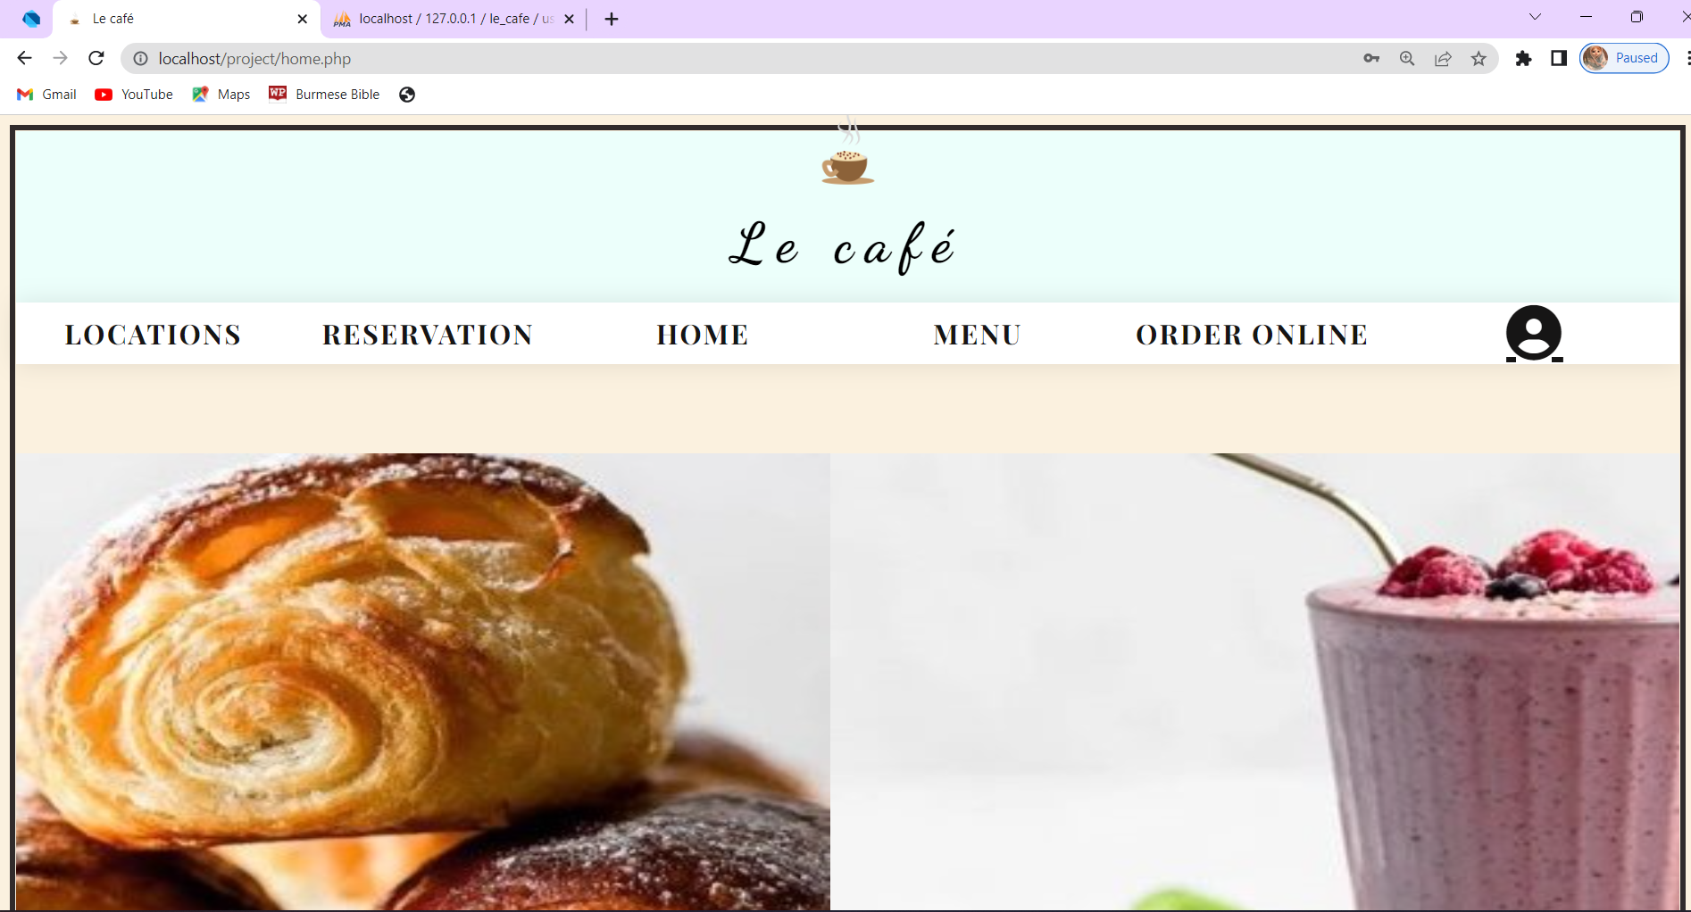
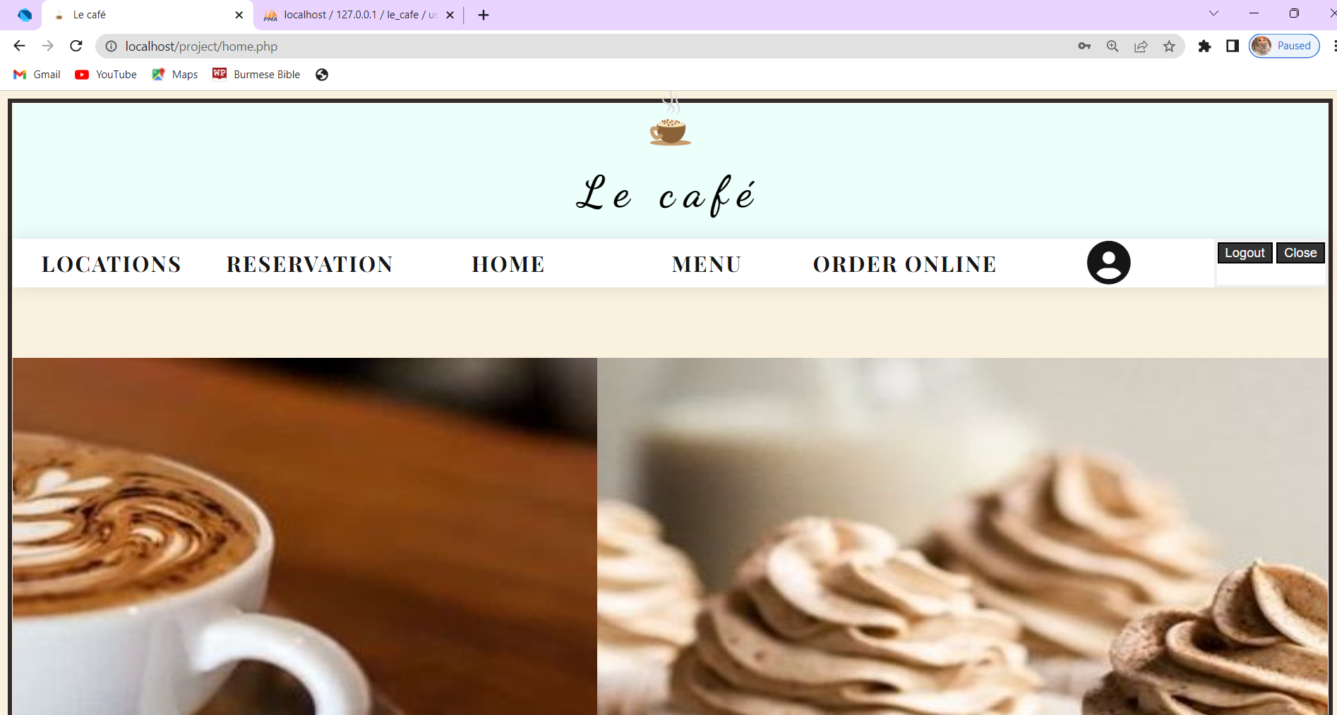
Website
Can log out and it will go back to log in page
Materials
Can change password

Slide 8
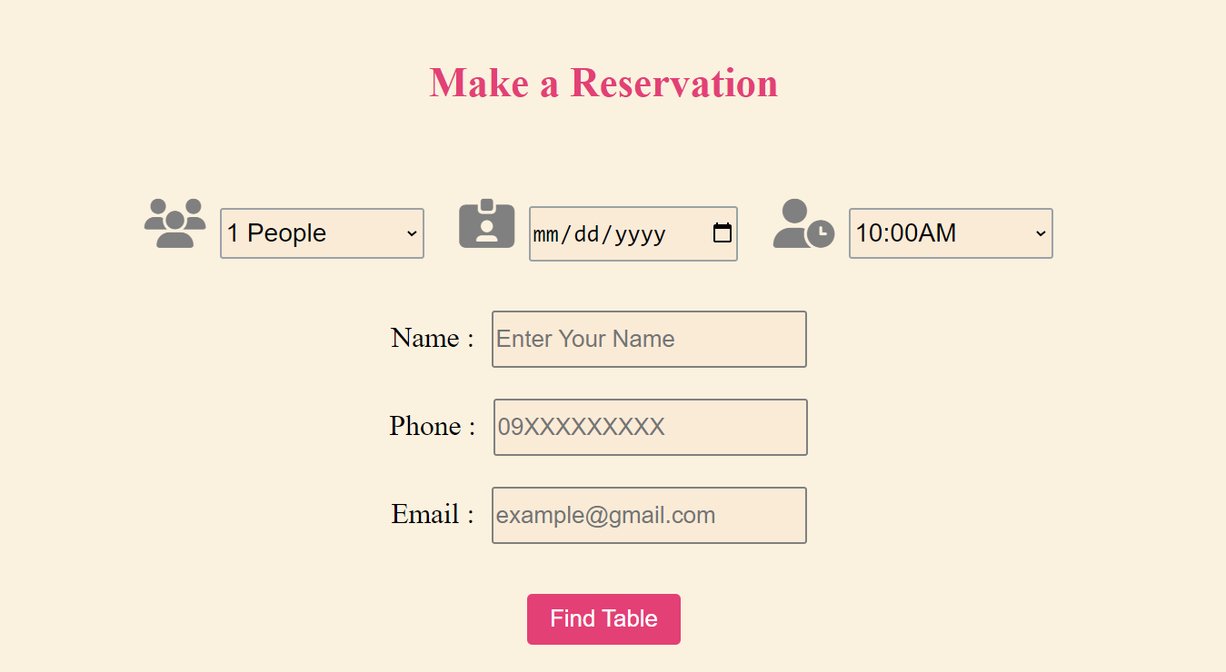
Website
Materials
Can fill the form to make a reservation

Slide 9
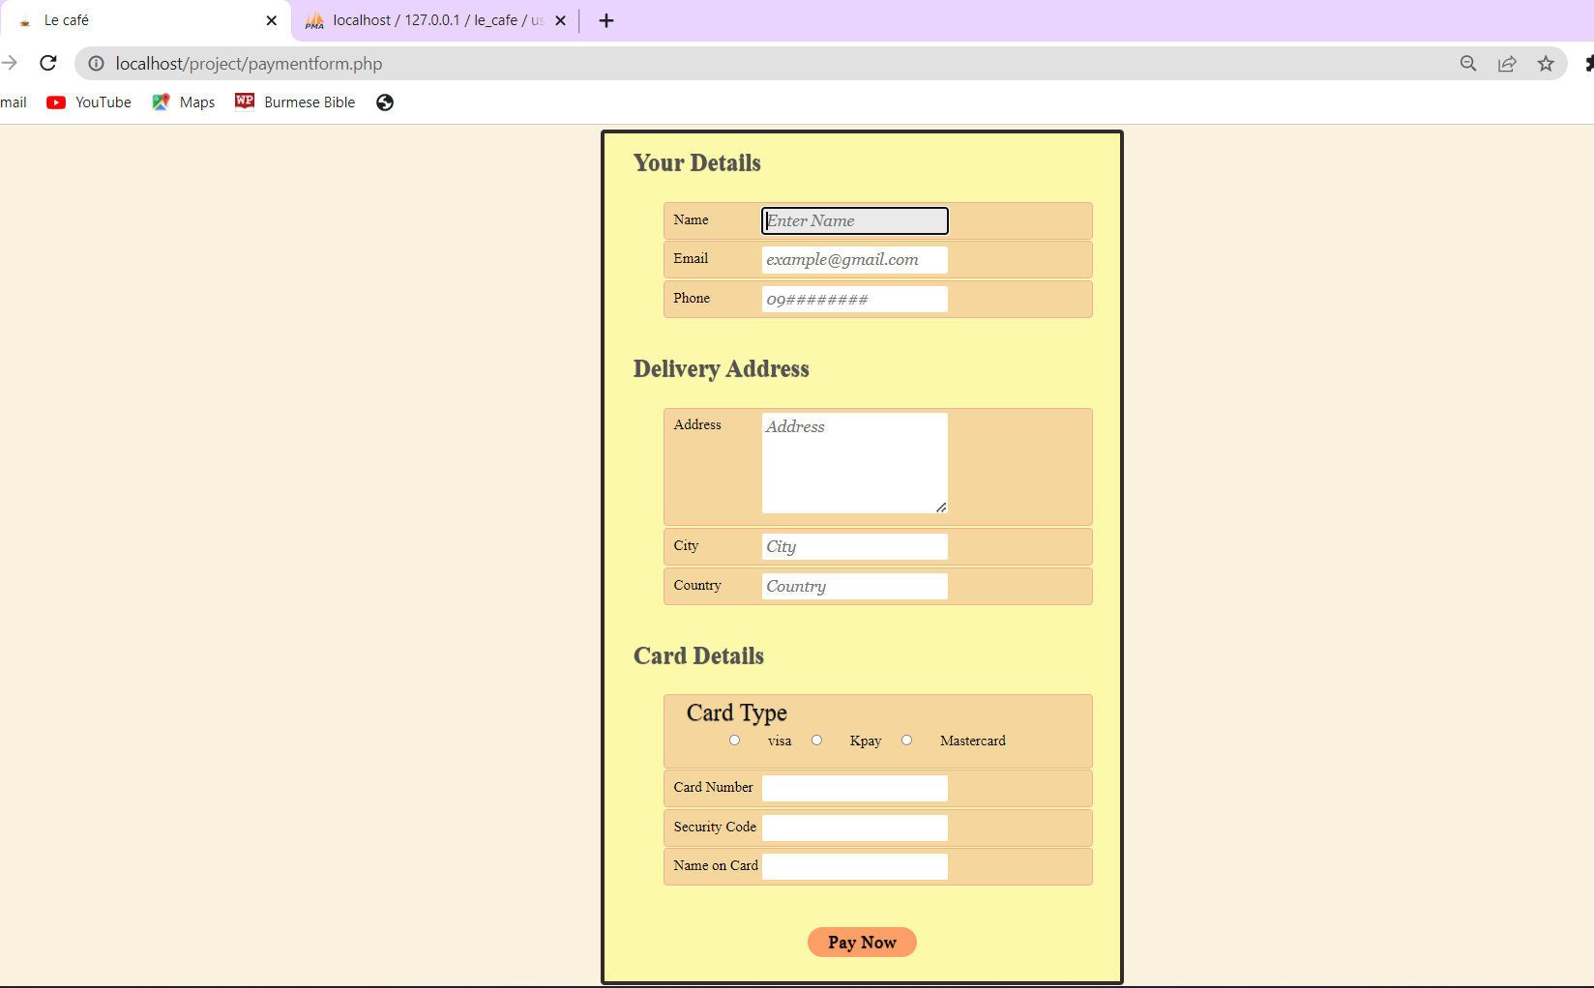
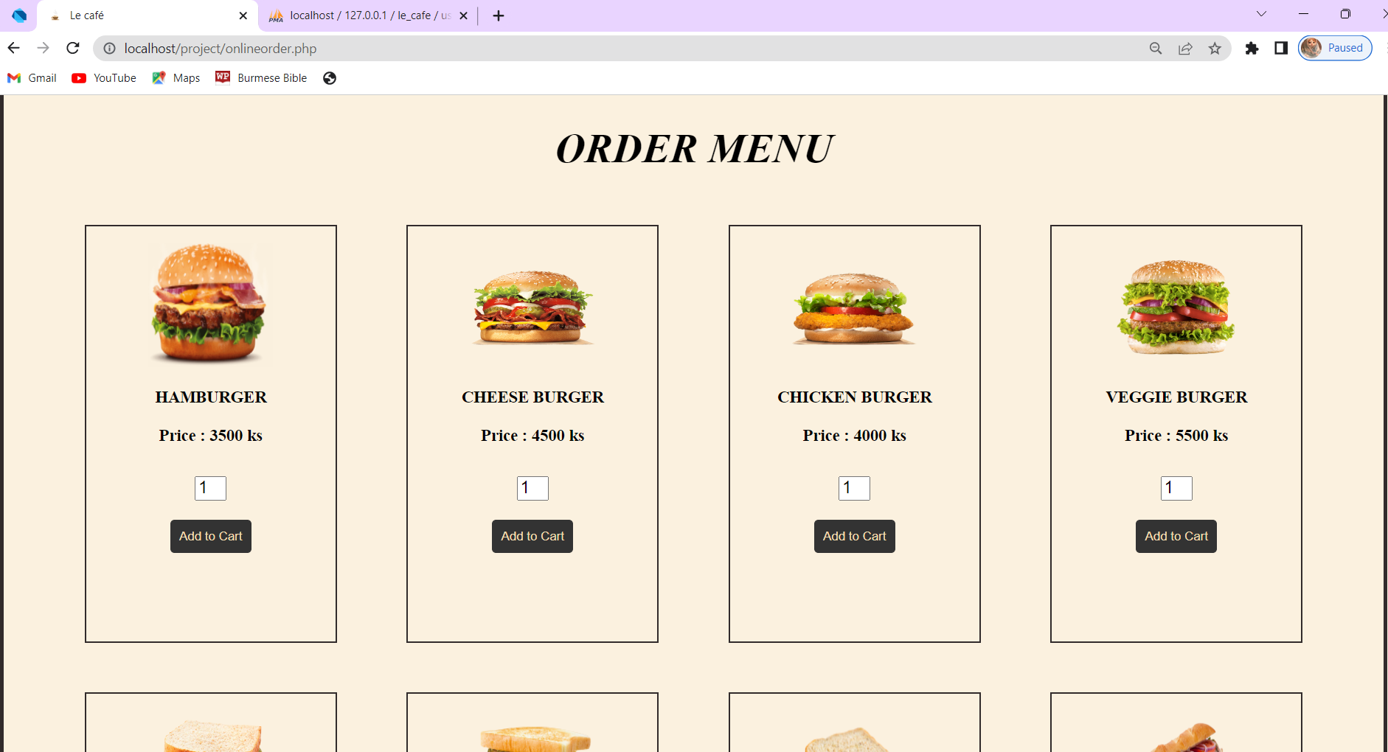
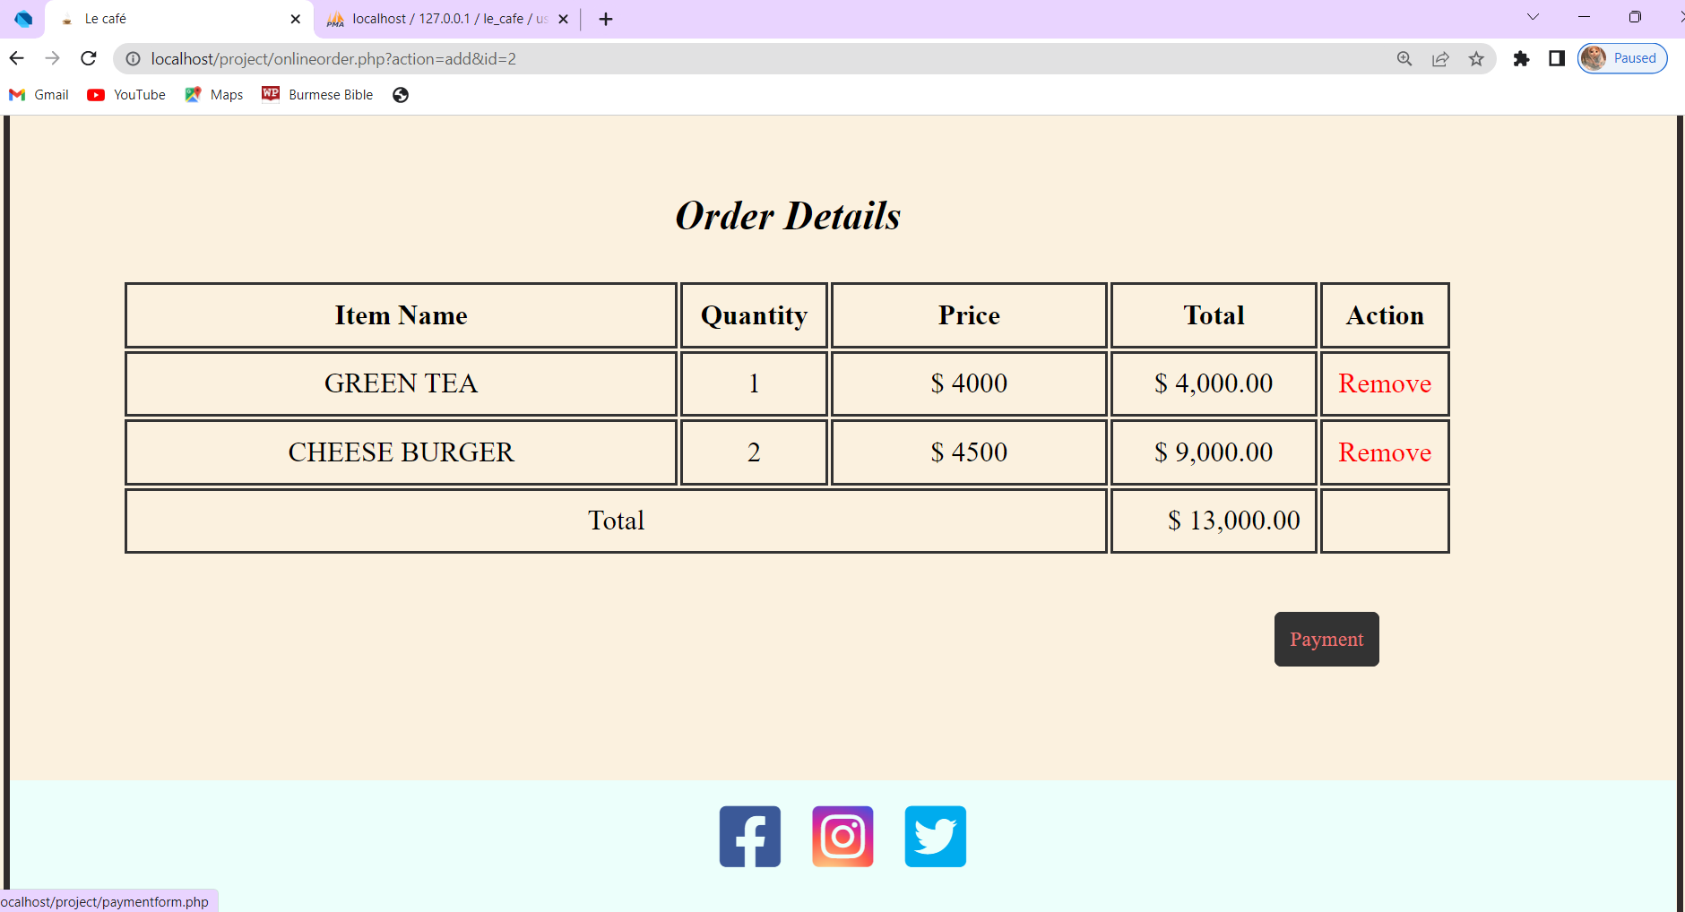
Website
Materials
Can choose the food & the quantity
Will show you the chosen food & total amount
Fill the form to make the payment

Slide 10
THANK
YOU

